Slide 1
Capstone Project 1 – Slide Deck
By Vikram Singh

Slide 2
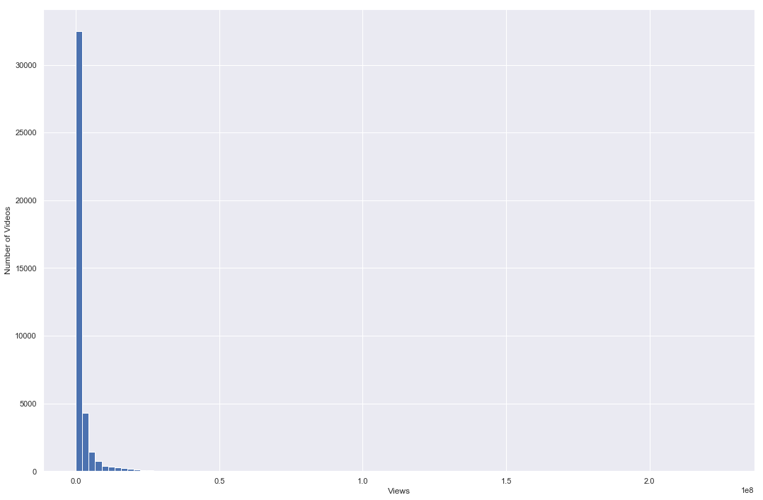
Views Distribution

Slide 3
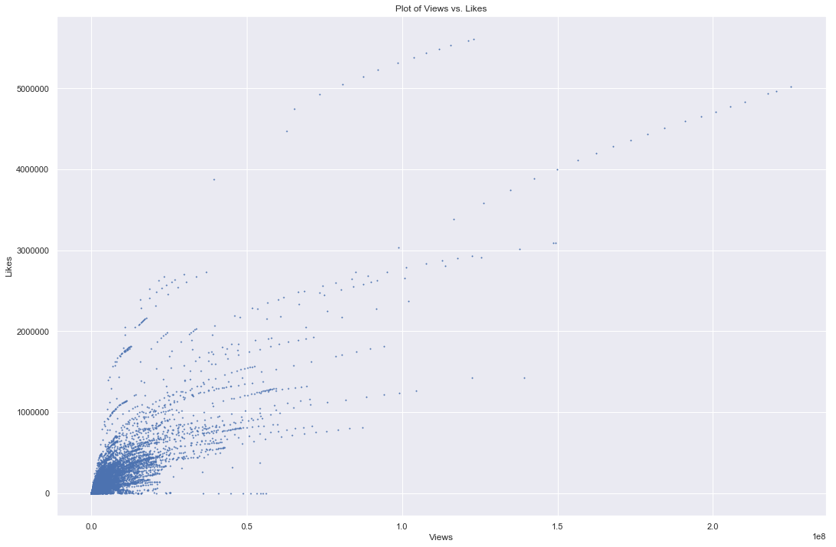
Views vs. Likes

Slide 4
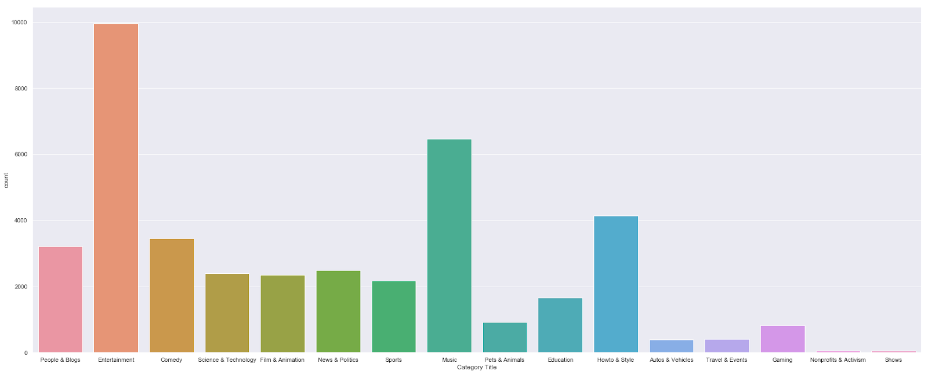
Count plot of Videos per Category

Slide 5
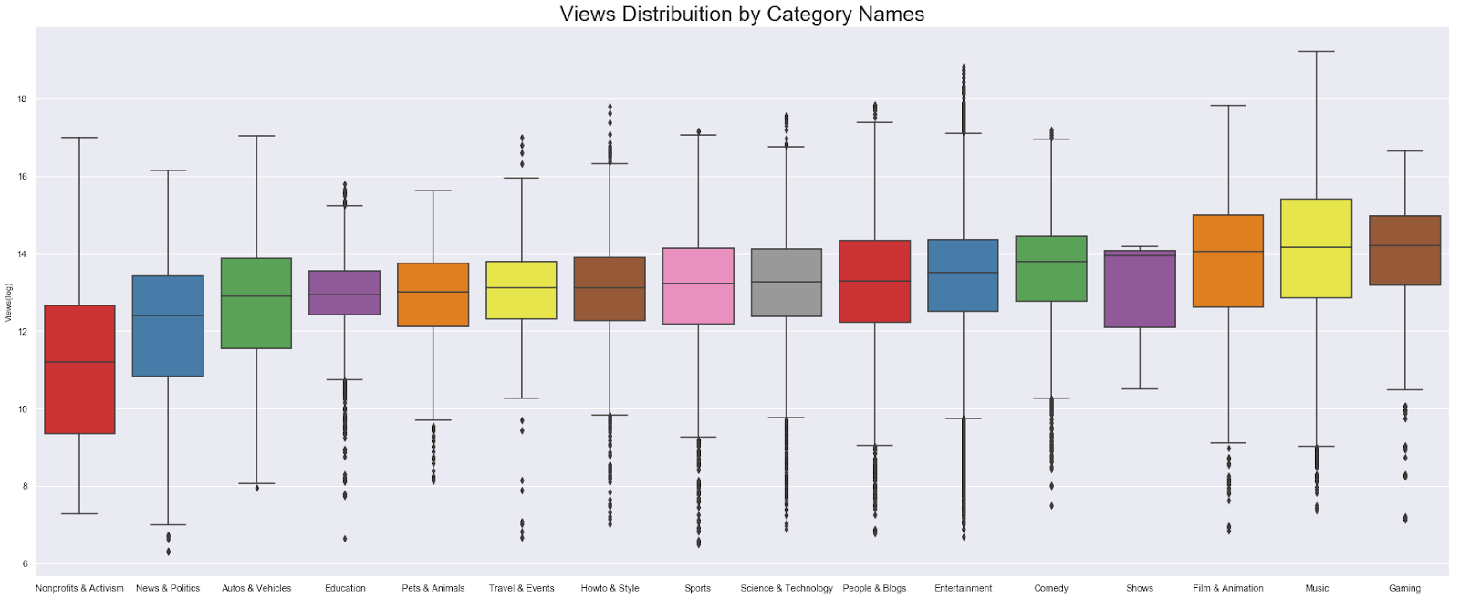
Log scaled Boxplot of Views per category – sorted by median

Slide 6
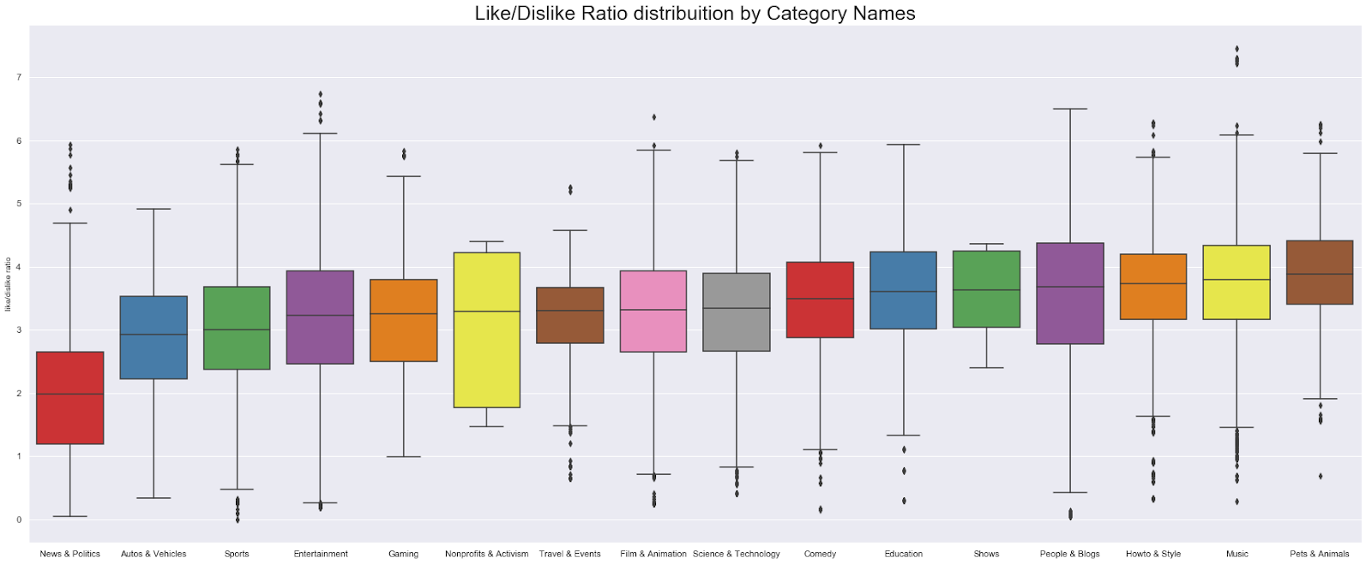
Like/Dislike Ratio by Category

Slide 7
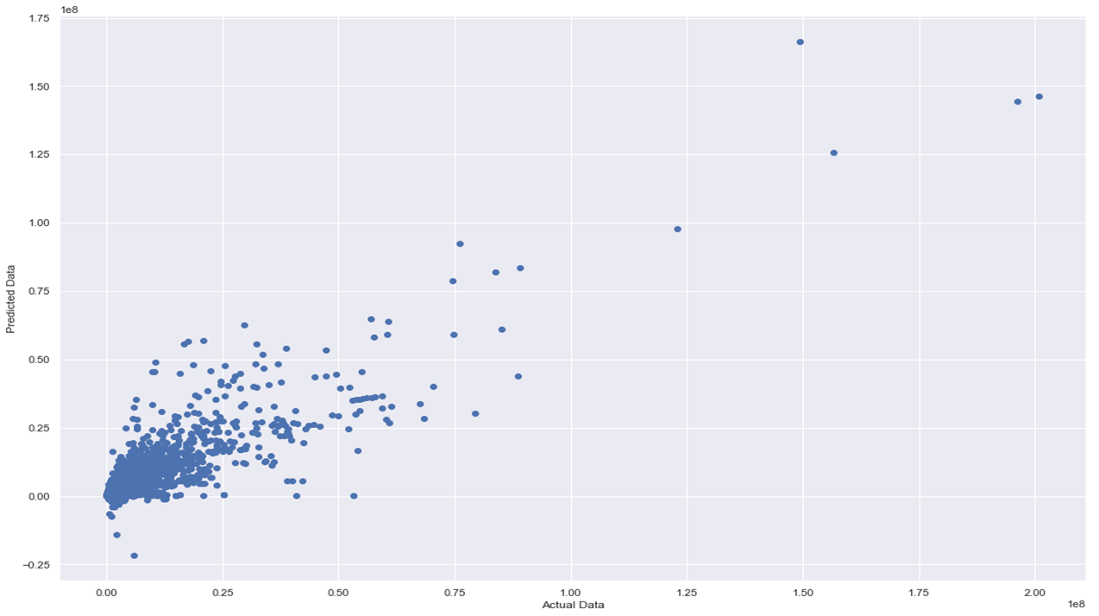
Machine Learning – Actual vs. Predicted values for Linear Regression (R = ~ 0.87 – 0.89)

Slide 8
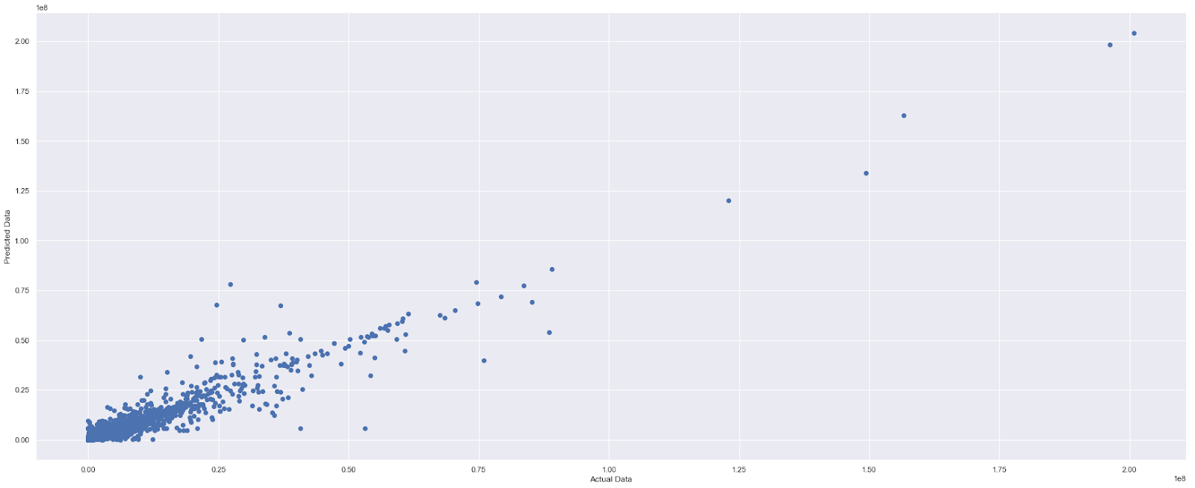
Machine Learning – Actual vs. Predicated values for Random Forest Regression (R = ~ 0.96 – 0.97)

Slide 9
Recommendations
Any entity which uses Youtube as a promotion platform, and any current or aspiring content creator, can benefit from these recommendations.
Attention should be focused on videos in the music category for the best results.
Music is the consistently top performing category on youtube in terms of public reception, and breadth
Videos of this category performed extremely well in both of these metrics
This might not be obvious initially when considering that youtube is platform for uploading video content rather than audio, but music videos are amongst the most popular videos on the site.
Despite the features of this category being strongly impacted by such music videos, analysis of the entire dataset confirms that this positive performance exists in general.

Slide 10
Recommendations
Popularity does not necessarily reflect positivity.
Some of the most popular categories on Youtube in terms of views, are some of the least popular categories in terms of public rating.
Entertainment videos are the most commonly trending, yet are generally received more poorly than most categories.
This margin is even more apparent with gaming videos, which has the highest median number of views of any category, yet performs on the same level as Entertainment in terms of public reception.
Niche categories such as Pets and Animals, Howto & Style, and People & Blogs to promote content serve as a solid balance between receiving ample views, and public reception.
Videos of a category such as Sports will attract attention, but typically aren’t received well by the public and can reasonably be avoided to an extent.

